Slide 1
How to merge bibliographic records manually
within one institution
Yoel Kortick
Senior Librarian

Slide 2
Agenda
Introduction
Retrieving duplicate records to merge - Alma Analytics
Retrieving duplicate records to merge – a dedicated Alma job
The merge rules
The steps to merge bibliographic records
Merging the bibliographic records – a live example
2

Slide 3
Introduction

Slide 4
Introduction
This presentation will show how two bibliographic records (not linked to the Community Zone), presumably which are the same “work”, can be merged into one bibliographic record.
The merge, in the example here, is done manually in the Metadata Editor.
  In a separate presentation we will deal with batch merging of bibliographic records via the job Merge and Combine Inventory.
In addition to this presentation see also Merging Bibliographic Records

Slide 5
Introduction
The manual merging of bibliographic records applies for
  Standalone institutions (institutions which are not part of a network zone consortia)
  Member institutions (institutions which are part of a network zone consortia)
  Network institutions (the network zone institution in a network zone consortia)
The subtitle of this presentation is “within one institution” because we are not dealing here with merging records between multiple member institutions or between a member institution and a network institution.

Slide 6
Introduction
As explained at Merging Bibliographic Records:
  It is possible to merge two bibliographic records only when both records are Institution Zone records, or both are Network Zone records.
  It is not possible to merge an Institution Zone bibliographic record with a Network Zone bibliographic record in the manner shown here.

Slide 7
Introduction
In the example here, because the bibliographic records we will show are for the purposes of merging, we will first identify duplicate records which have the same inventory.
Finding duplicate records with different types of inventory, “overlap analysis for electronic and physical resources”, is a different topic and not related to the merging of bibliographic records which we are discussing here.
Typically, when two bibliographic records are merged, they have the same type of inventory.
Further, the bibliographic records which are merged cannot be connected to the Community Zone.

Slide 8
Introduction
Before we begin looking at the process of merging bibliographic records, we will briefly look at two options for identifying duplicate records:
  Alma Analytics
  A dedicated Alma job called “Duplicate Title Analysis”

Slide 9
Retrieving duplicate records to merge – Alma Analytics

Slide 10
Retrieving duplicate records to merge – Alma Analytics
One option to find duplicate bibliographic records is to use the analytics dashboard “Title level overlap analysis” which is located at “/shared/Alma/Titles/Dashboards
  The tab “Overlap P and P” will create a report of duplicate records which all have physical (P) inventory
The overlap will be determined by the identifier chosen in the “Find overlap by” field.

Slide 11
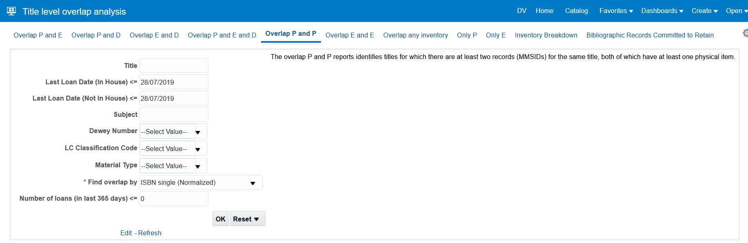
Retrieving duplicate records to merge – Alma Analytics
The following for example, using the “Overlap P and P” tab, will give us a report of duplicate titles by ISBN, and all titles will have physical inventory

Slide 12
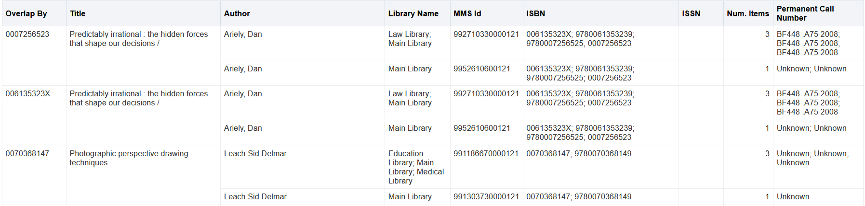
Retrieving duplicate records to merge – Alma Analytics
Here is part of the results
Let’s look for example at ISBN 0007256523

Slide 13
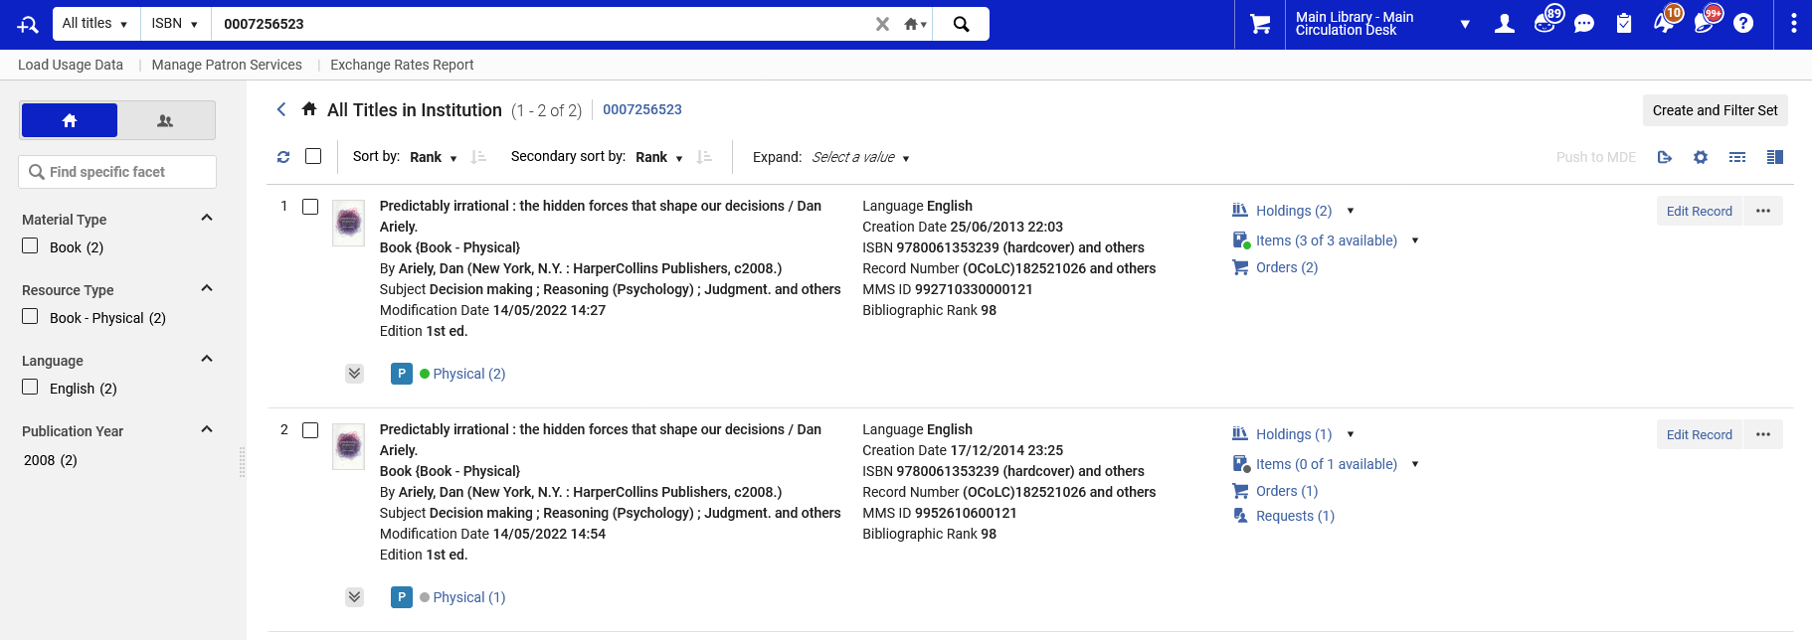
Retrieving duplicate records to merge – Alma Analytics
Here is the duplicate title with ISBN 0007256523

Slide 14
Retrieving duplicate records to merge – a dedicated Alma job

Slide 15
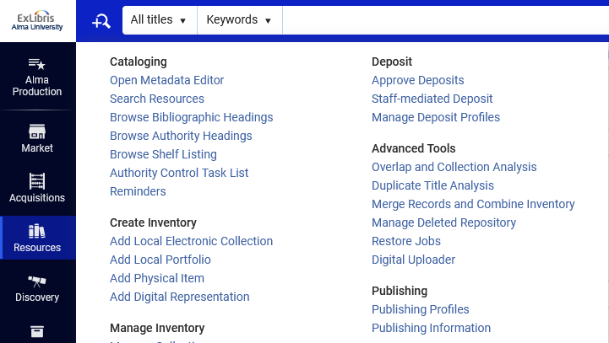
Retrieving duplicate records to merge – a dedicated Alma job
Another option to find duplicate bibliographic records is to use the dedicated Alma job Duplicate Title Analysis.

Slide 16
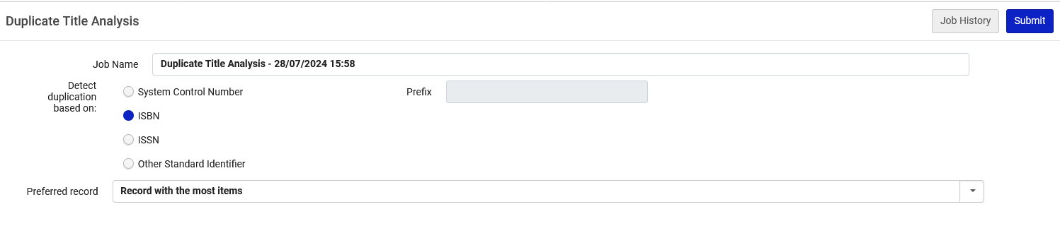
Retrieving duplicate records to merge – a dedicated Alma job
The following for example will give us a report of duplicate titles by ISBN
The choice of “Preferred record” field is relevant when the output of “Duplicate Title Analysis” is used as input for the “Merge Records and Combine Inventory” job.
In this presentation we will not be using the Merge Records and Combine Inventory job, as we are dealing here with merging records manually.

Slide 17
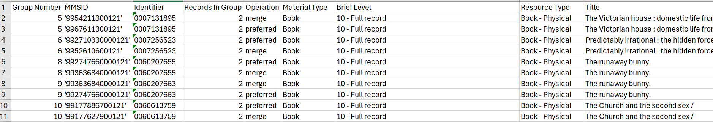
Retrieving duplicate records to merge – a dedicated Alma job
Here is part of the results. These are all duplicate titles by ISBN.
Let’s look for example at ISBN 0007131895

Slide 18
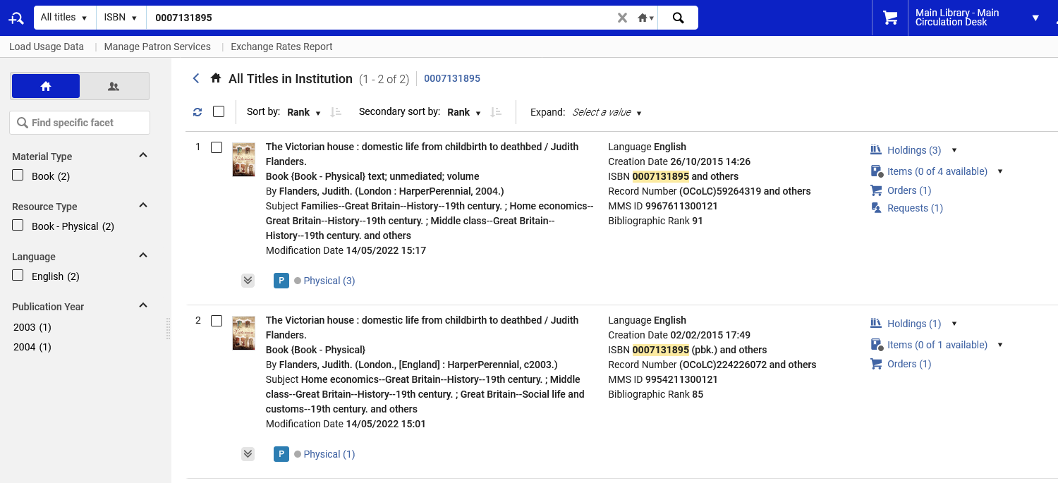
Retrieving duplicate records to merge – a dedicated Alma job
Here is the duplicate title with ISBN 0007131895

Slide 19
The merge rules

Slide 20
The merge rules
When combining bibliographic records manually via the Metadata Editor a merge rule is used.
The merge rule is chosen at the time of merging.
This presentation will not deal with the syntax of the merge rules, but rather how they are used when performing the manual merging of bibliographic records.
For details about the syntax and creation of merge rules see:
  Alma Merge Rule Examples
  Working with Merge Rules

Slide 21
The steps to merge bibliographic records

Slide 22
The steps to merge bibliographic records
Alma provides the ability to merge two bibliographic records (not linked to the Community Zone) in the Metadata Editor.
This is helpful when catalogers identify duplicate bibliographic records in the catalog.
The merge is handled by selecting one of the merge rules from a list of predefined merge routines.

Slide 23
The steps to merge bibliographic records
Merging two bibliographic records into one bibliographic record will move the following entities from the merged (secondary) to the merged (primary) record:
  PO line
  Electronic collections
  Electronic portfolios
  Physical items
  Digital representations
  Loans
  Requests
  Reading lists
  Related record relationship (based on MMS ID)

Slide 24
The steps to merge bibliographic records
Steps to merge two bibliographic records using the Metadata Editor: (1 of 3)
Locate the two bibliographic records that need to be merged. The primary record will be updated with the information from the secondary record.
Edit both records so that they both appear under the Records tab in the Metadata Editor.
From the Navigation pane under the Records tab, select the primary record.
Select the Split Editor icon and select the secondary record so that it appears on the right.
Select Record Actions > Merge Records & Combine. The Merge Records and Combine Inventory dialog box appears.
Review any messages displayed.

Slide 25
The steps to merge bibliographic records
Steps to merge two bibliographic records using the Metadata Editor: (2 of 3)
Select a merge routine from the drop-down list. The merge routines that appear in the list are pulled from the Merge Rules list under the Rules tab in the Metadata Editor.
To preview the merge results, select Show merge preview. Select OK to close the Merge Preview view.
Optionally, select Update holdings call number. When you select this option, the system updates the call number information (using the bibliographic call number) for all the holdings associated with the primary record. This change is applied to the holdings associated with the primary record after the bibliographic merge was processed. Note that if one of the call number fields is updated in the bibliographic record, this may affect the call number that eventually appears in the holdings records.

Slide 26
The steps to merge bibliographic records
Steps to merge two bibliographic records using the Metadata Editor: (3 of 3)
Select how to handle the secondary bibliographic record (after the merge) from the following options:
    Delete
    Suppress
    Keep it
When ready to merge the two records, select OK.

Slide 27
Merging the bibliographic records – a live example

Slide 28
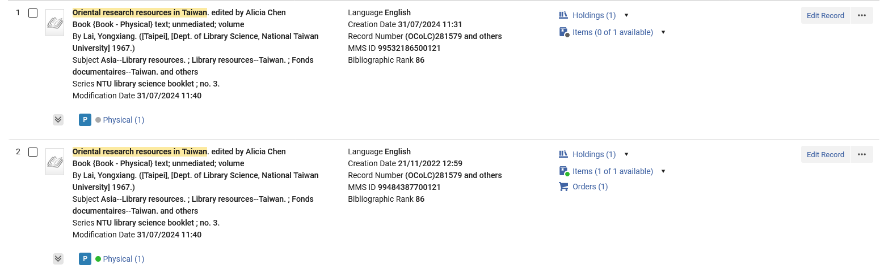
Merging the bibliographic records – a live example
The title of the two records we will merge is “Oriental research resources in Taiwan. edited by Alicia Chen”

Slide 29
Merging the bibliographic records – a live example
The MMSIDs are 99484387700121 and 99532186500121
  99484387700121 will be the primary record and 99532186500121 will be the secondary record
  99484387700121 has a 583 field and 99532186500121 does not
  99532186500121 has a 900 field and 99484387700121 does not
  As we can see in the previous slide:
    99484387700121 has 1 holdings record, 1 available item (Barcode AU67527) and one POL
    99532186500121 has 1 holdings record and 1 on loan item not available (it is loaned) (Barcode AU67985)

Slide 30
Merging the bibliographic records – a live example
Both records are now in the metadata editor in split editor mode.
The primary record (99484387700121) is on the left and the secondary record (99532186500121) is on the right.

Slide 31
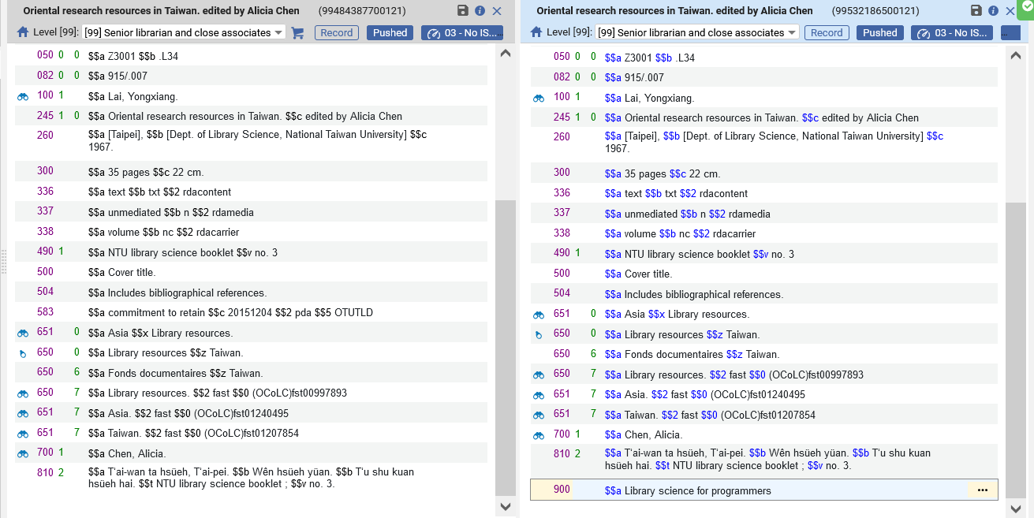
Merging the bibliographic records – a live example
The primary record (99484387700121) is on the left
The secondary record (99532186500121) is on the right.

Slide 32
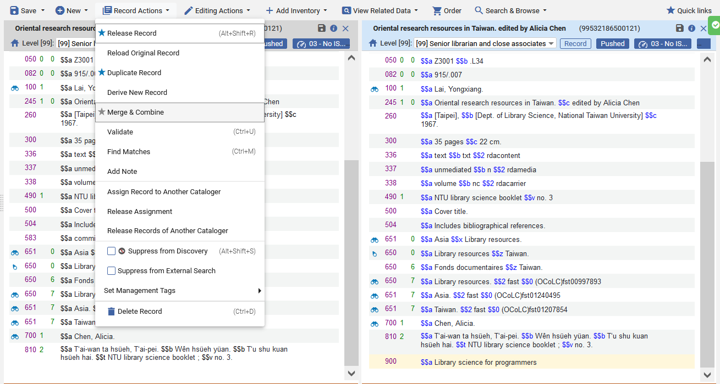
Merging the bibliographic records – a live example
The cataloger does “Record Actions > Merge & Combine”

Slide 33
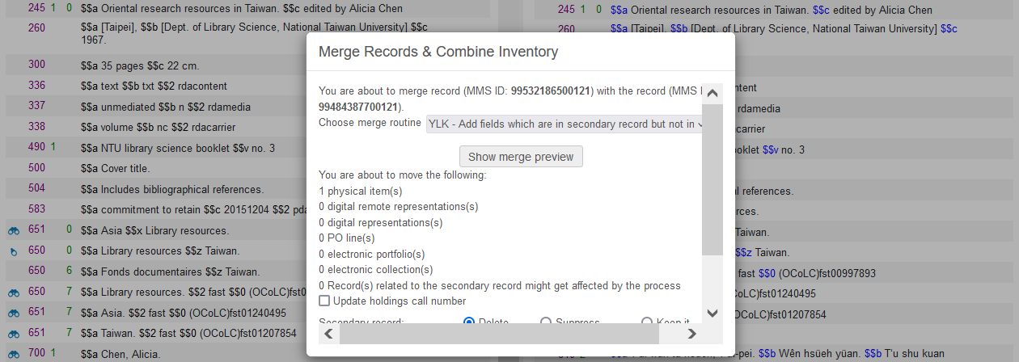
Merging the bibliographic records – a live example
The cataloger chooses a merge routine. We will choose “YLK - Add fields which are in secondary record but not in primary record except for 020 022 and 776”
We will now click “Show merge preview”

Slide 34
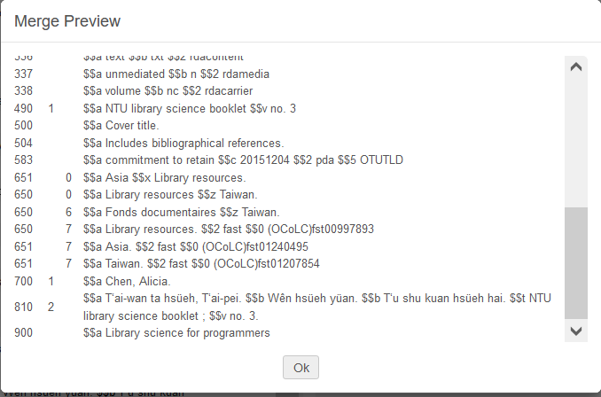
Merging the bibliographic records – a live example
We see in the ”Merge Preview” that the record has both the 583 (from the primary record) and the 900 (from the secondary record).
This is a result of the specific merge routine we chose.
We will now click “OK”

Slide 35
Merging the bibliographic records – a live example
The dialog box states “You are about to move the following: 1 physical item(s)”
That is because the secondary record has 1 physical item
The holdings record, item and POL of the primary record are not moving. They stay with the primary record.
We have three options of what to do with the secondary record:
  Delete
  Suppress
  Keep it
We will choose “Delete” and click OK

Slide 36
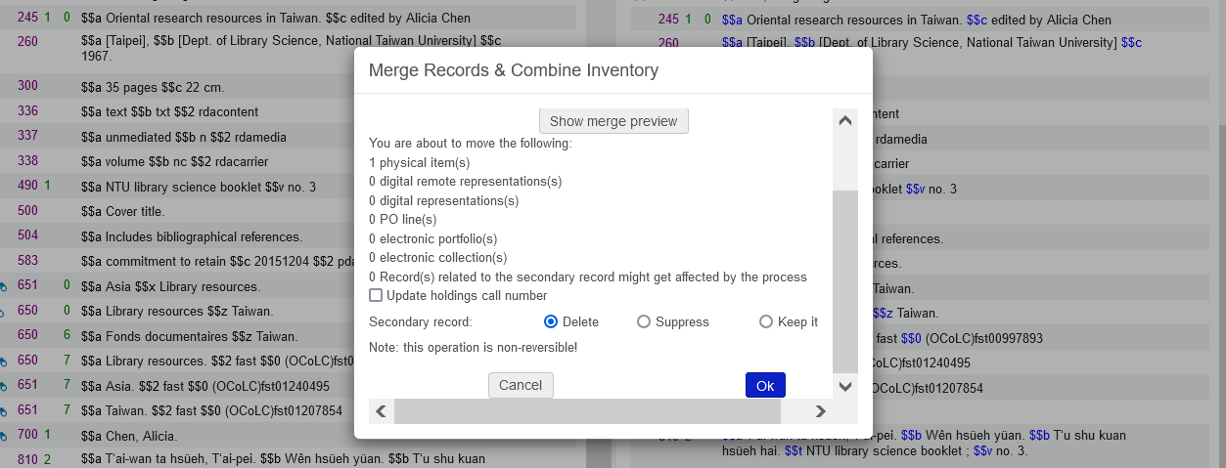
Merging the bibliographic records – a live example
This will merge the records

Slide 37
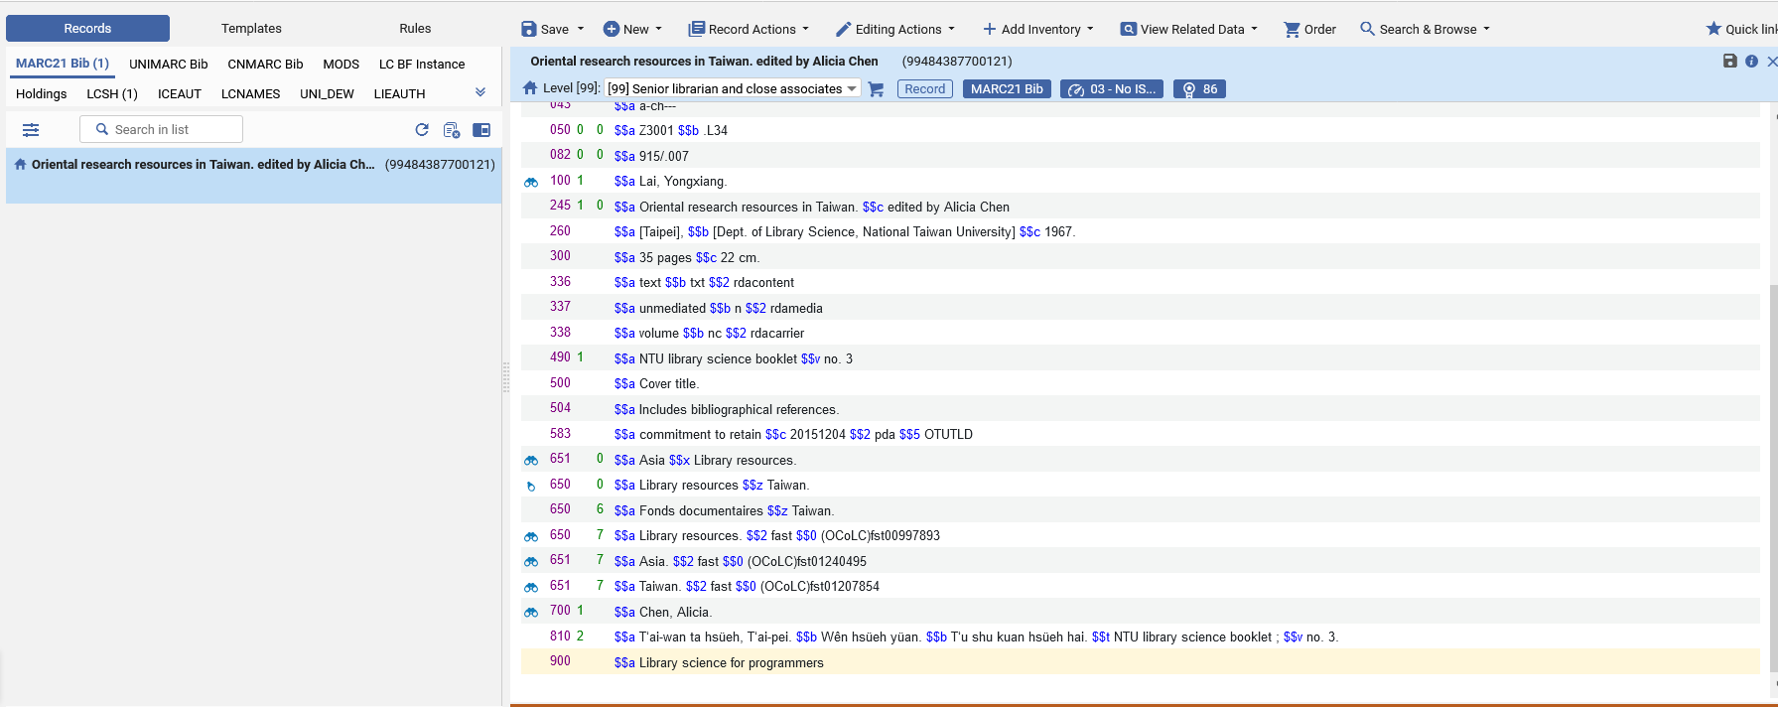
Merging the bibliographic records – a live example
Now we have the one merged record with both the 583 and 900 fields
This is (what was) the primary record and still has the same MMSID (99484387700121)

Slide 38
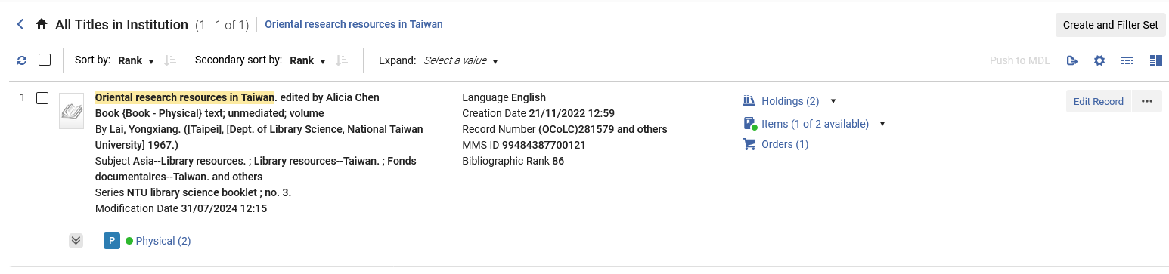
Merging the bibliographic records – a live example
Now we have the one merged record with
  two holdings records (one from primary record and one from secondary record) and two items (one from primary record and one from secondary record)
  one item available (from primary record) and one item not available (on loan) (from secondary record)
  one POL (from primary record)

Slide 39
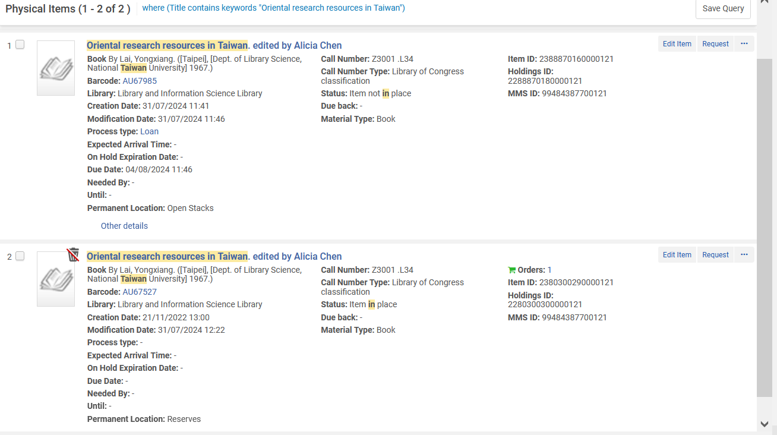
Merging the bibliographic records – a live example
Here are both items of the same merged MMSID 99484387700121. One is on loan, and one is not
This item (Barcode AU67985) was formerly (before the merge) on loan and part of MMSID 99532186500121.
Now it is still on loan and part of merged MMSID 99484387700121.

Slide 40
Merging the bibliographic records – a live example
In summary:
  We have successfully merged two bibliographic records
  The bibliographic fields were merged in accordance with the merge routine chosen during the merge process.
  The related inventory information also was merged and an item on loan came from the secondary record and remained on loan after the merge with the same barcode.

Slide 41
Thank You

